Slide 1
ClaimSwift
Microservices-Based Insurance Claims Processing Platform
Java • Spring Boot • MySQL • Angular
Team members
Shashank Nath
K Navya
Vikas Rawat Shlok Pauriyal Meghana T C

Slide 2
Project Objectives
Automate Claim Lifecycle
Streamline submission, verification, approval, and payment processes with minimal manual intervention
Microservices Architecture
Build independent, scalable services that can be developed, deployed, and maintained separately
Secure Access Control
Implement role-based authentication ensuring data security and appropriate permissions across all system levels
Distributed System
Create a resilient, fault-tolerant platform that maintains availability during service failures or maintenance

Slide 3
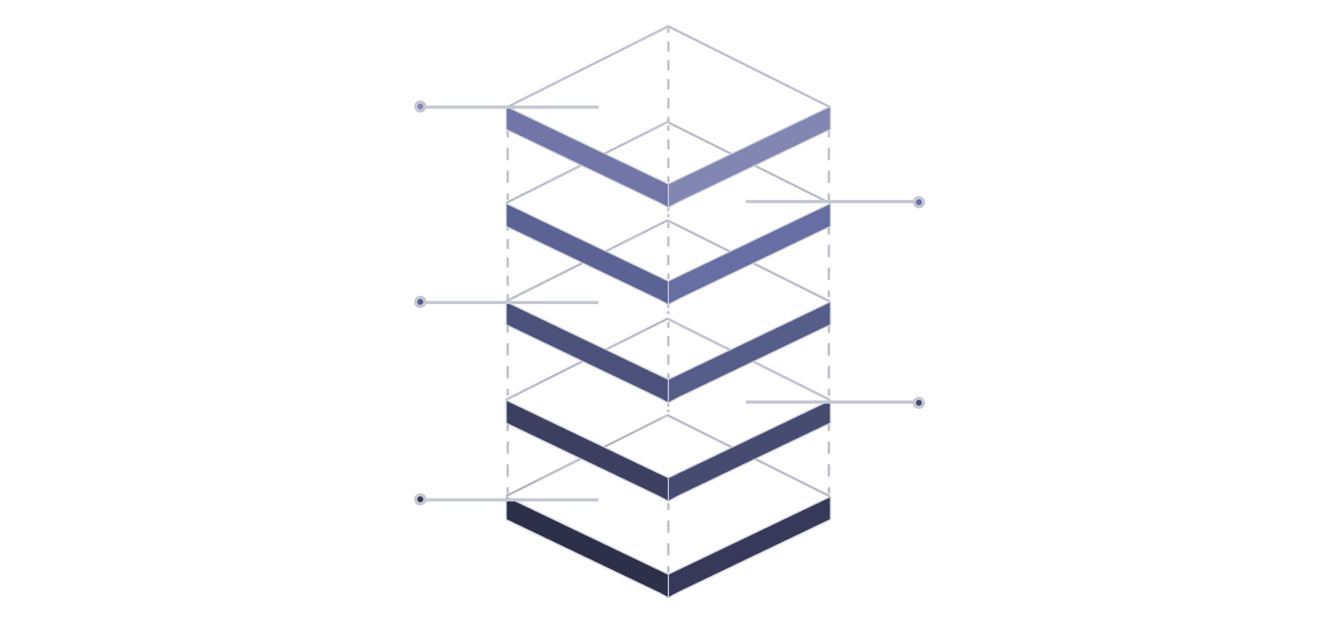
System Architecture Overview
Databases
Each service owns its database for isolation
Microservices
Auth, Claim, Document, Assessment, Payment, Notification, Reporting
Config Server
Centralized configuration for services
Service Discovery
Locate microservice instances dynamically
API Gateway
Unified entry for all client requests

Slide 4
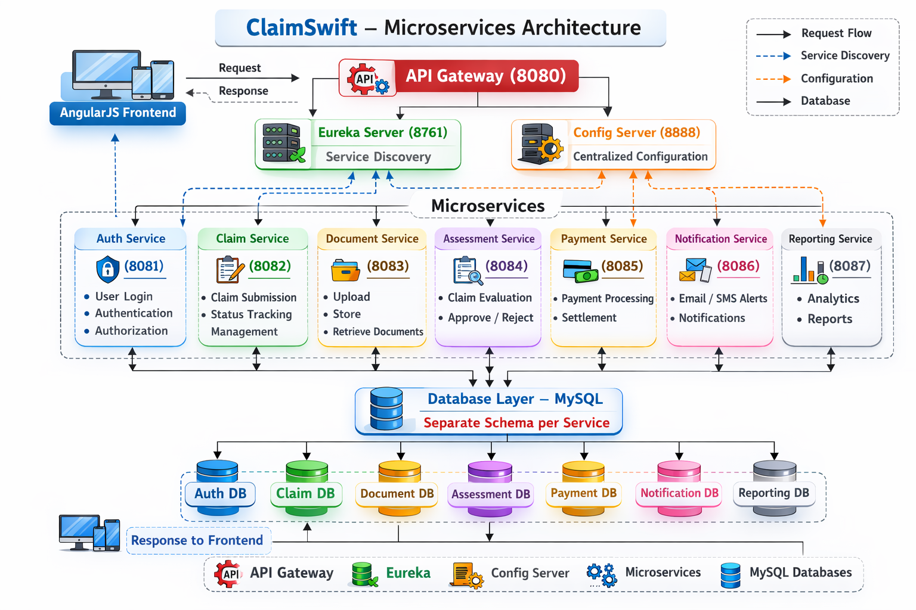

Slide 5
Core Technology Stack
Frontend & Framework
Infrastructure & Security
Angular for responsive UI
Spring Boot for backend services
Spring Cloud for distributed architecture
Maven for build management
MySQL for relational data
Eureka for service discovery
Spring Security with JWT tokens
Spring Cloud Config Server

Slide 6







Authentication & Security Architecture
JWT Authentication
Token Validation
Role-Based Access
Stateless token-based authentication provides secure, scalable user verification without server session storage
Each microservice validates JWT tokens independently, ensuring secure API access across distributed system
Granular permission control ensures users access only appropriate functionality based on assigned roles
Defined User Roles
Admin
Policyholder
System configuration and user management
Submit claims and track status
Adjuster
Manager
Evaluate claims and assess damage
Approve settlements and oversee operations

Slide 7
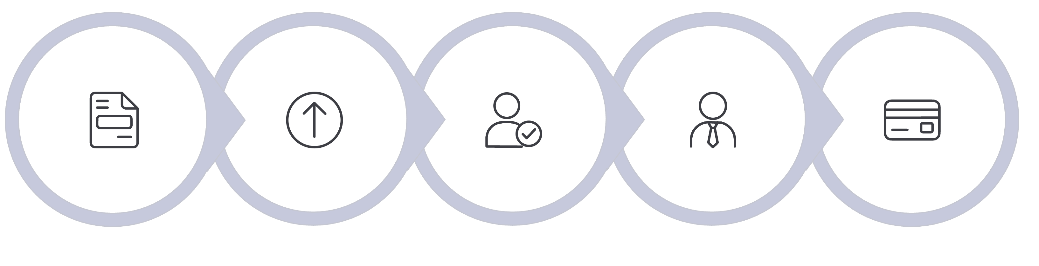
Claim Processing Workflow
Claim Submitted
Document Upload
Adjuster Assessment
Manager Approval
Payment Processing
The automated workflow ensures consistent processing while maintaining appropriate human review at critical decision points. Each stage triggers notifications and updates the claim status in real-time.

Slide 8

Database Design Strategy
Data Isolation Approach
Each microservice maintains its own database to ensure loose coupling and independent scalability. Services cannot directly access other services' databases, enforcing clear boundaries and preventing tight dependencies.
Service-Specific Schemas
Event-Driven Integration
Each service defines its own data model optimized for its specific business requirements
Services communicate changes through domain events rather than direct database access
Data Consistency
Distributed transactions managed through saga pattern and compensating actions

Slide 9
Error Handling & Validation
Global Exception Handling
Centralized error handling using @ControllerAdvice provides consistent error responses across all microservices. Captures exceptions and returns standardized error formats.
Validation Mechanisms
Bean Validation (JSR-380) for data integrity
Request/response validation at API boundaries
Custom validators for business rules
Validation annotations on DTOs
Secure Error Responses
Generic error messages prevent information leakage while detailed logs enable debugging. Error codes map to specific resolution steps.

Slide 10
Thank you

